Slide 1


https://reurl.cc/R1rO89
早
https://github.com/chiustin/NTU_Artifical_Intelligence_in_Chemistry_with_Keras

Slide 2

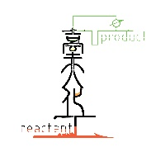
Deep Learning (I)
楊延齡
d00524018@ntu.edu.tw
09/08/2020

Slide 3
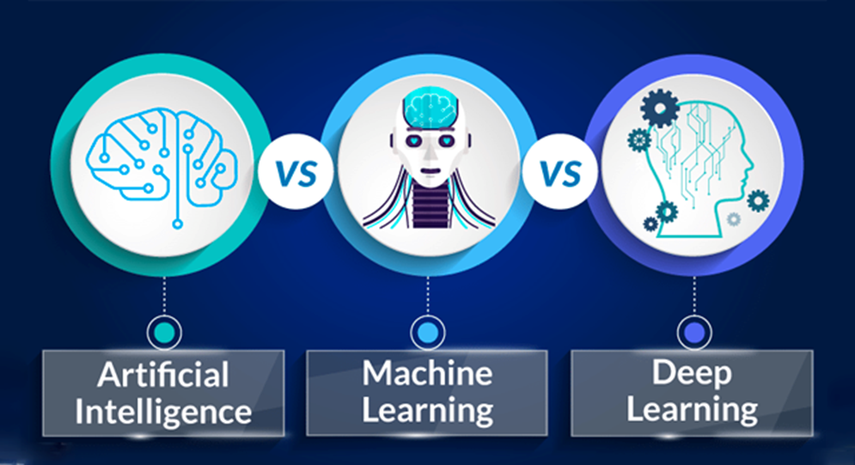
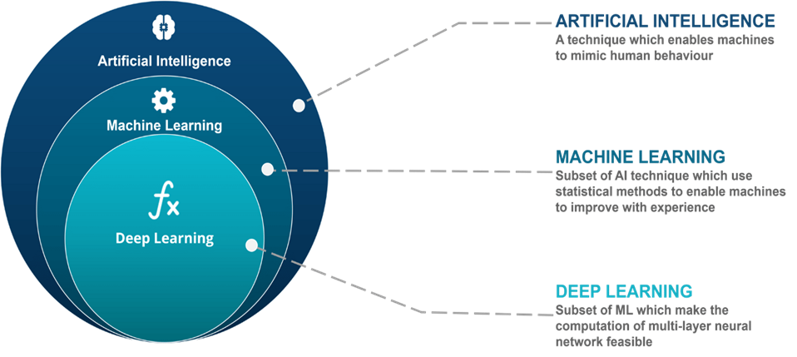
Artificial Intelligence vs Machine Learning vs Deep Learning

Slide 4
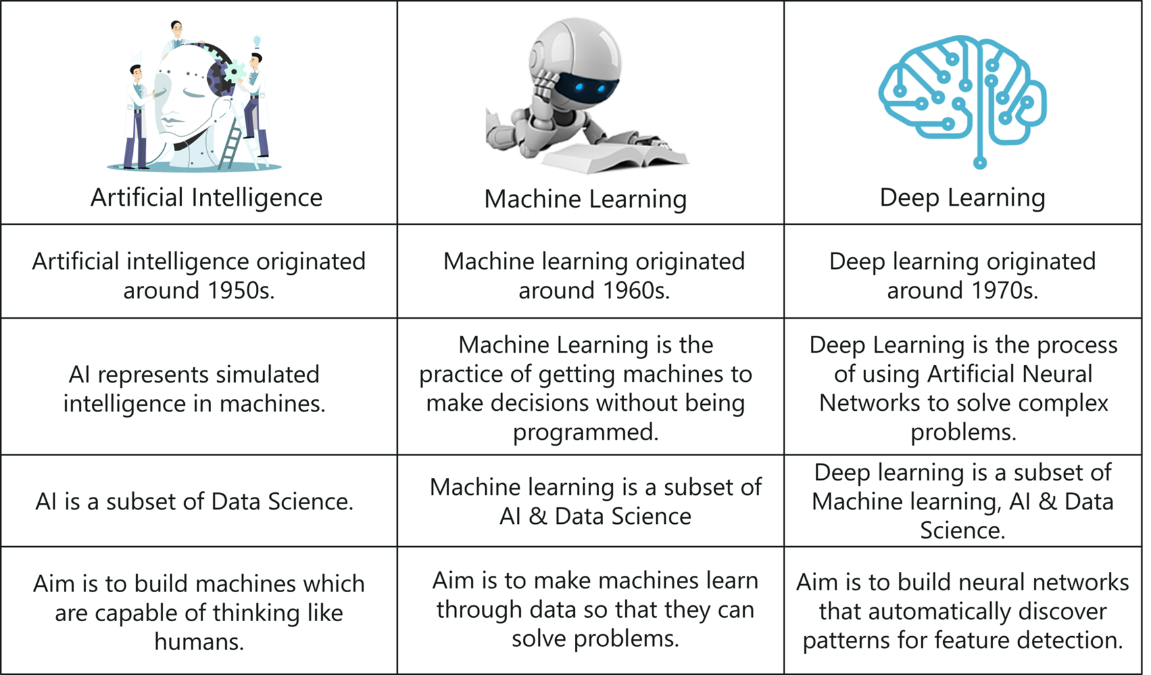

Slide 5
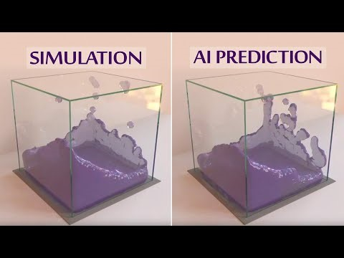
How Well Can an AI Learn Physics?

Slide 6
Application
Image Recognition
Sentiment Analysis
News Classification
Video Surveillance
Email Classification and Spam Filtering
Speech Recognition
Online Fraud Detection
Classification
Author Identification
Prediction
Regression
Services of Social Media
Medical Services
Recommendation for Products and Services
Online Customer Supports
Age/Gender Identification
Language Identification
Information Retrieval
Robot Control
Virtual Personal Assistant

Slide 7
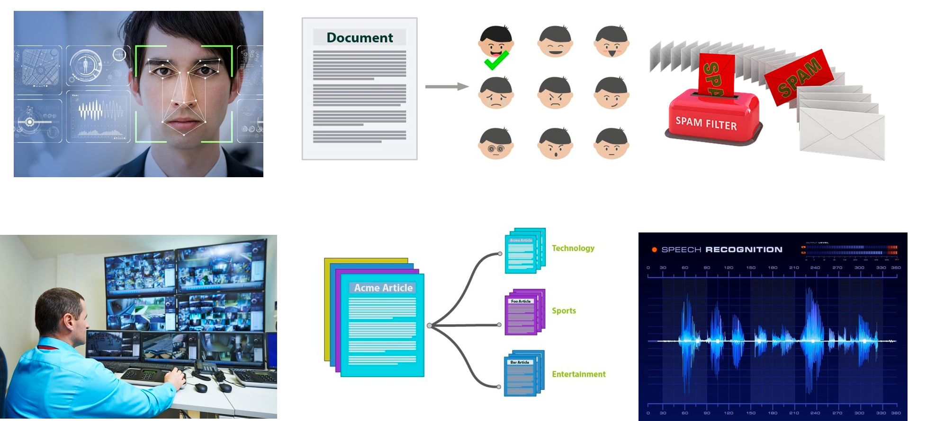
Application
Sentiment Analysis
Image Recognition
Email Classification and Spam Filtering
News Classification
Video Surveillance
Speech Recognition

Slide 8

Application
Online Fraud Detection
Medical Services
Online Customer Supports
Services of Social Media
Recommendation for Products and Services
Age/Gender Identification

Slide 9
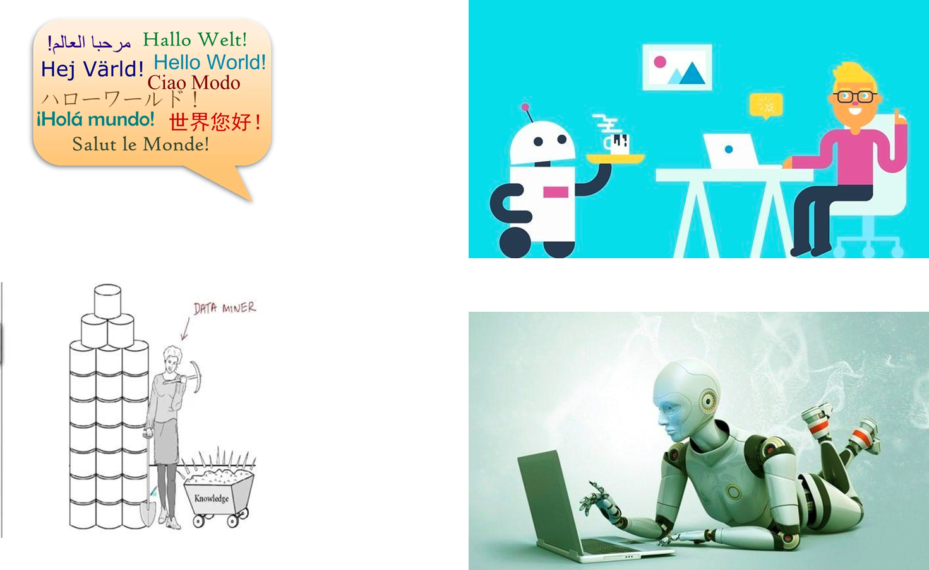
Application
Language Identification
Robot Control
Information Retrieval
Virtual Personal Assistant

Slide 10
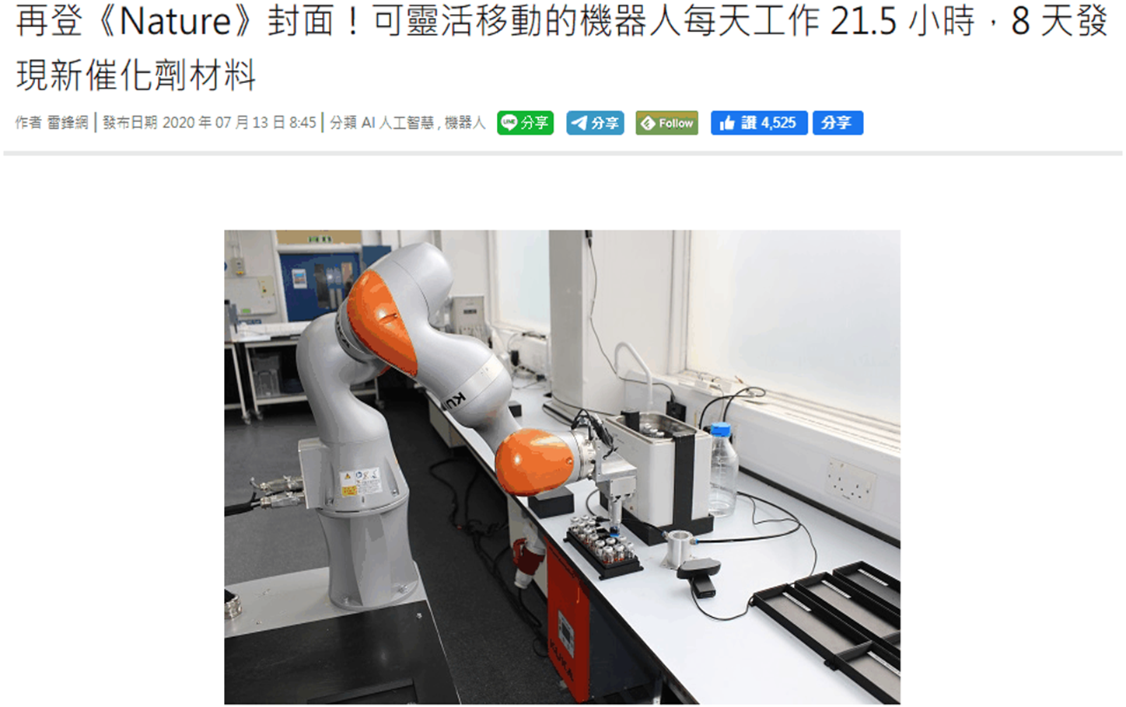
Application
Link

Slide 11
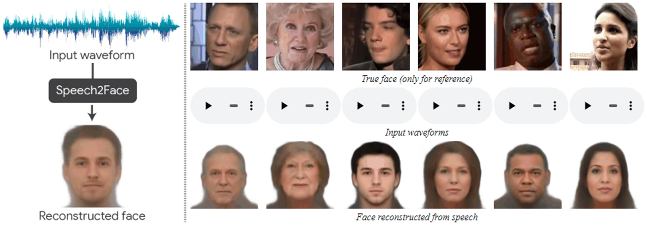
Learning the Face Behind a Voice
The model takes only an audio waveform as input!!!

Slide 12
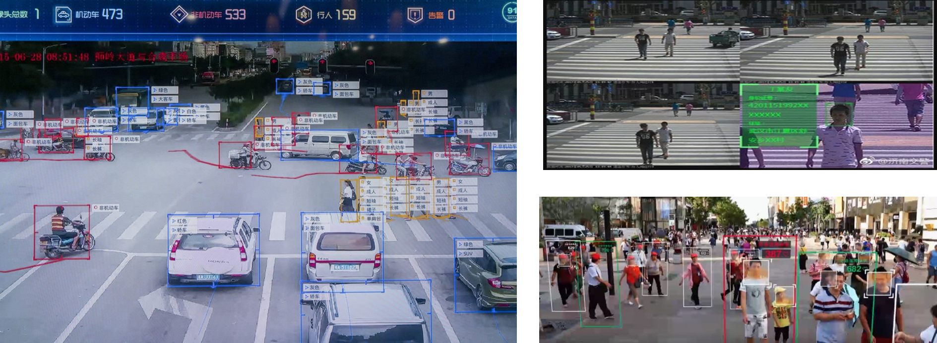
China’s Social Credit System
Plans to implement the social credit system in Beijing by the end of 2020

Slide 13
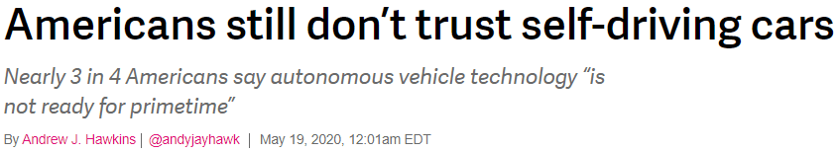
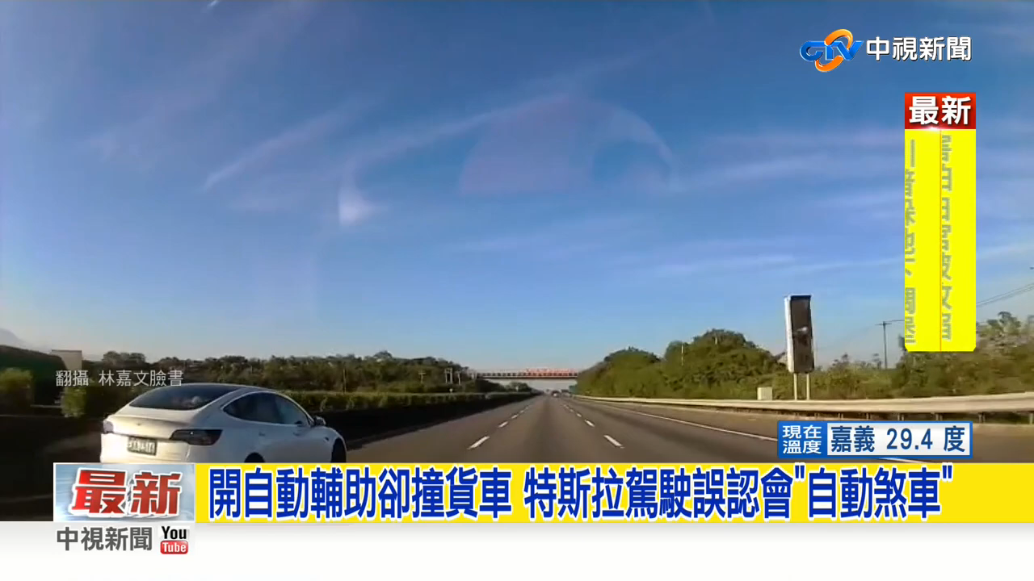
Trust or Distrust

Slide 14
Artificial Intelligence
Programmers handcraft a sufficiently large set of explicit rules for manipulating knowledge
Rules
Classical programming
Answers
Data
from the 1950s to the late 1980s
A machine-learning system is trained, presented with many examples relevant to a task, and it finds statistical structure in these examples that eventually allows the system to come up with rules for automating the task.
Data
Machine learning
Rules
Answers

Slide 15
Classical Machine Learning
Supervised Learning: Using data with fine-grained human-annotated labels to train networks
Unsupervised Learning: Without using any human-annotated labels

Slide 16
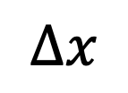


Supervised Learning
Classification
Regression
$$F$$
Pressure
$$F=k×Δx$$
Temperature
$$Δx$$
Output variable is categorical in nature
Output variable is a continuous numeric value

Slide 17
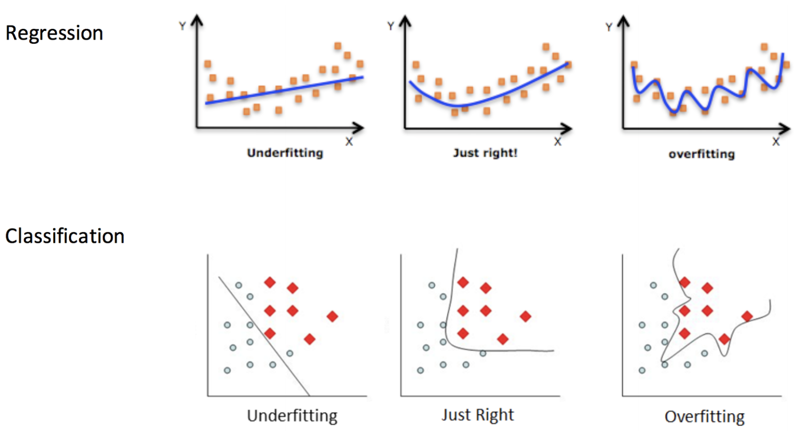
Machine Learning
The goal is to achieve models that generalize—that perform well on never-before-seen data—and overfitting is the central obstacle.

Slide 18
The Map of the Machine Learning World

Slide 19
Deep Learning
Artificial Neural Network
Input Layer
Hidden Layer
Output Layer

Slide 20
Deep Learning
Supervised Learning: Using data with fine-grained human-annotated labels to train networks
Unsupervised Learning: Without using any human-annotated labels
Semi-supervised Learning: Using a small amount of labeled data in conjunction with a large amount of unlabeled data
Weakly-supervised Learning: To learn with coarse-grained labels or inaccurate labels. The cost of obtaining weak supervision labels is generally much cheaper than fine-grained labels for supervised methods
Self-supervised Learning: A subset of unsupervised learning. Instead, the system learns to predict part of its input from other parts of it input

Slide 21

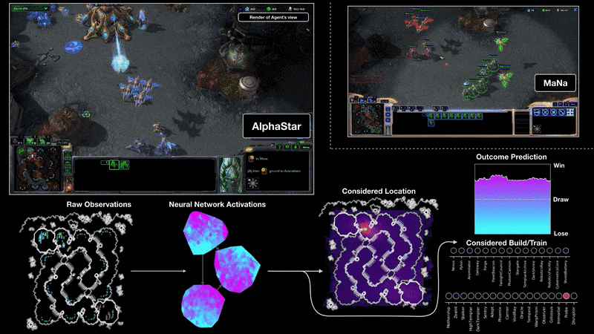
Application
https://deepmind.com/blog/alphastar-mastering-real-time-strategy-game-starcraft-ii/

Slide 22
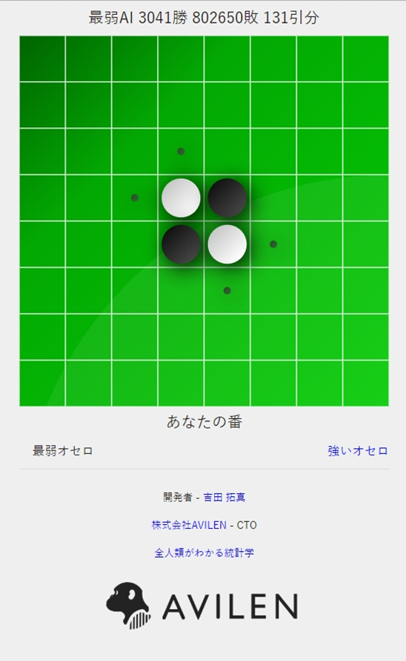
世界最弱のオセロAI作りました
https://othello.to-kei.net/weak/

Slide 23
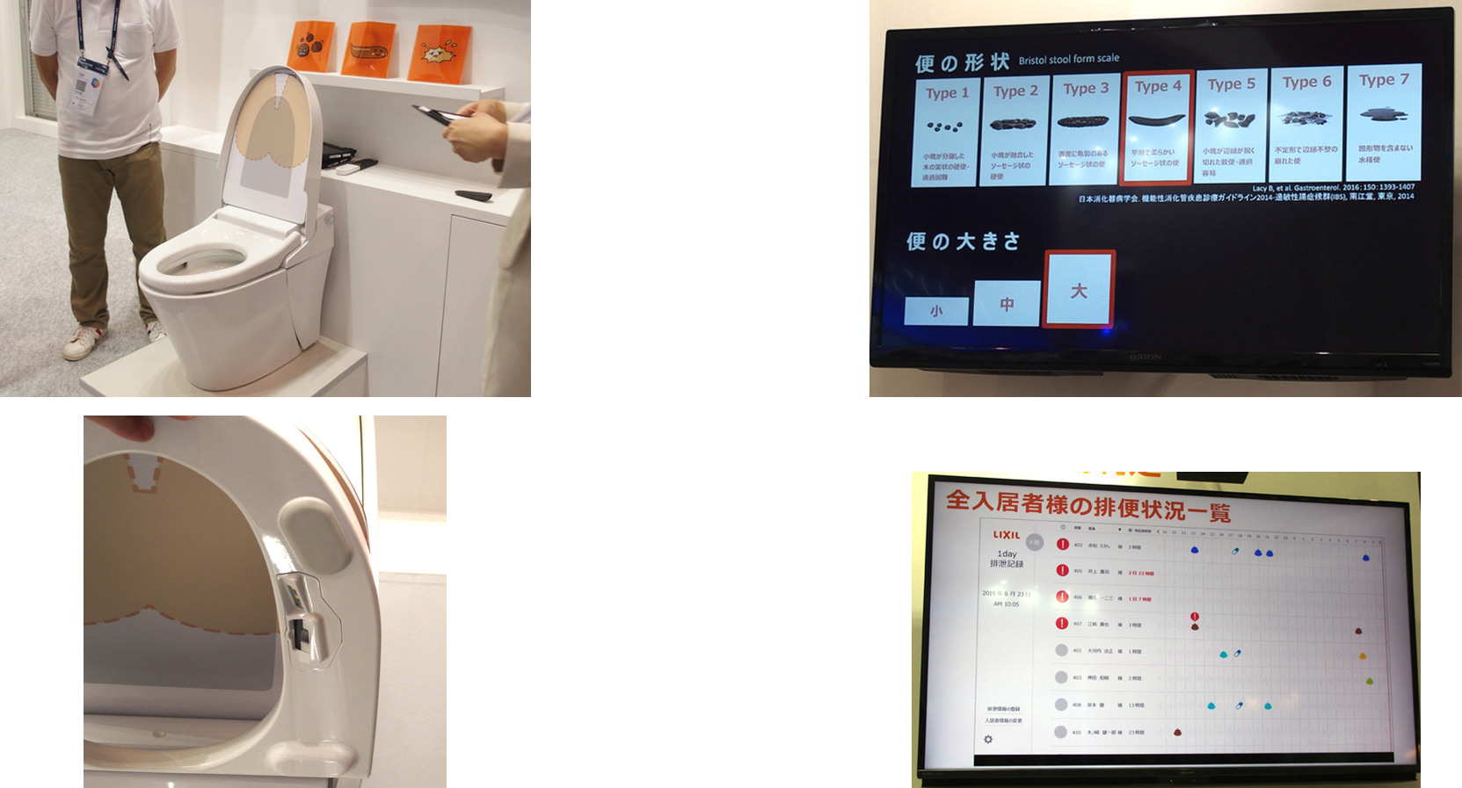
AI Toilet

Slide 24
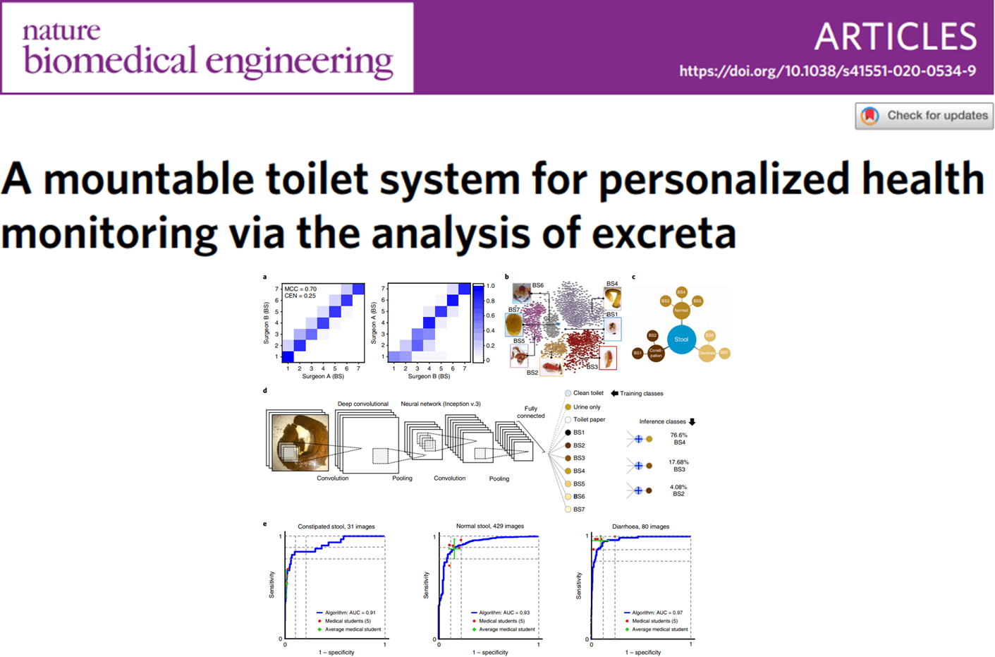
AI Toilet

Slide 25

AI Toilet
Link

Slide 26

GPT3
Link

Slide 27
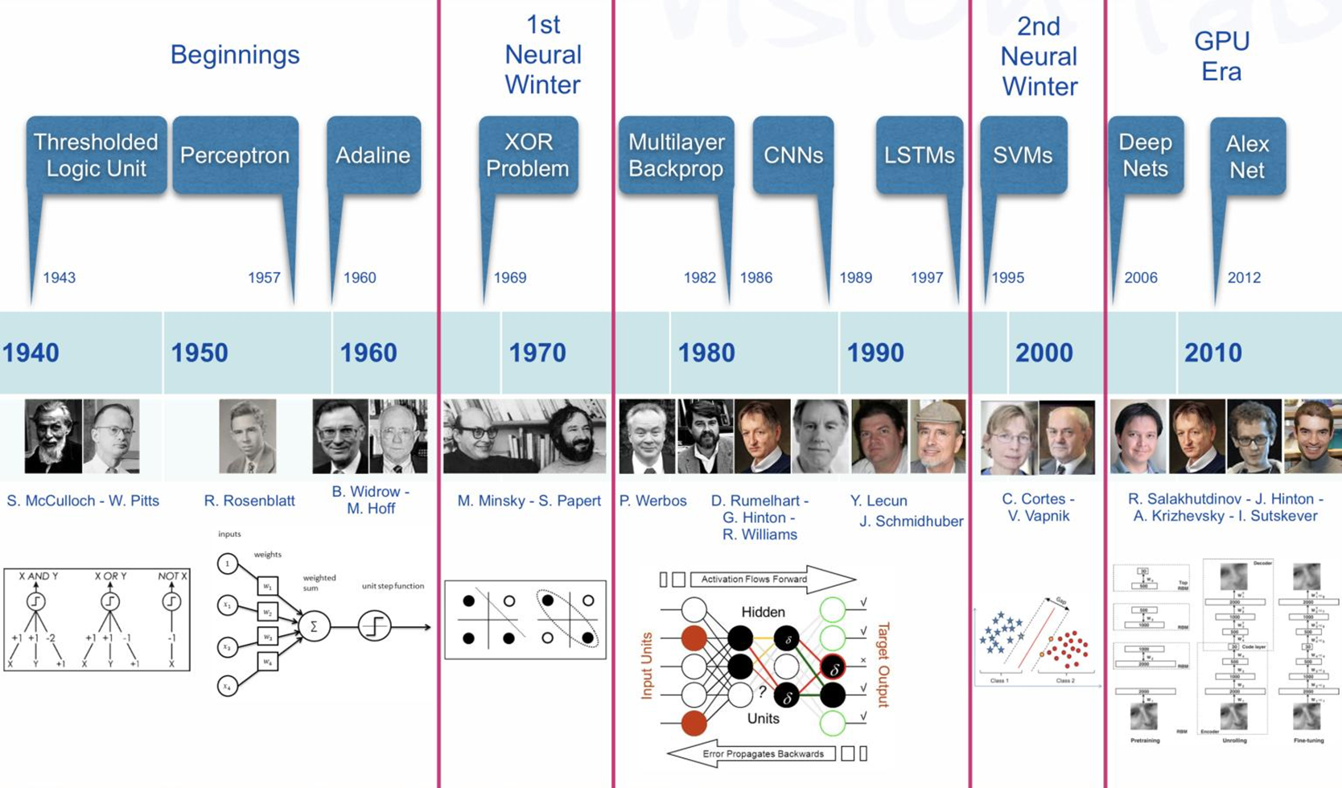
Deep Learning

Slide 28
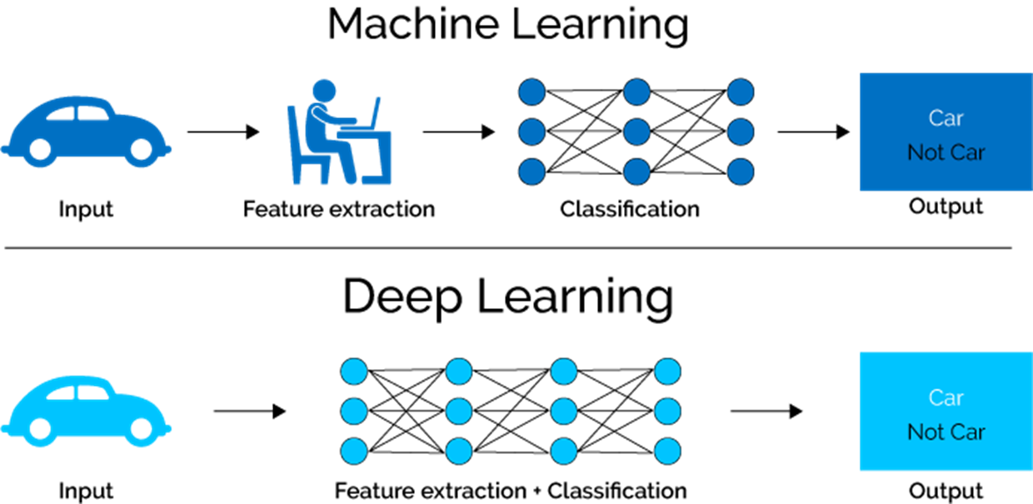
Machine Learning vs Deep Learning
When there is lack of domain understanding for feature introspection, Deep Learning techniques outshines others as you have to worry less about feature engineering.

Slide 29
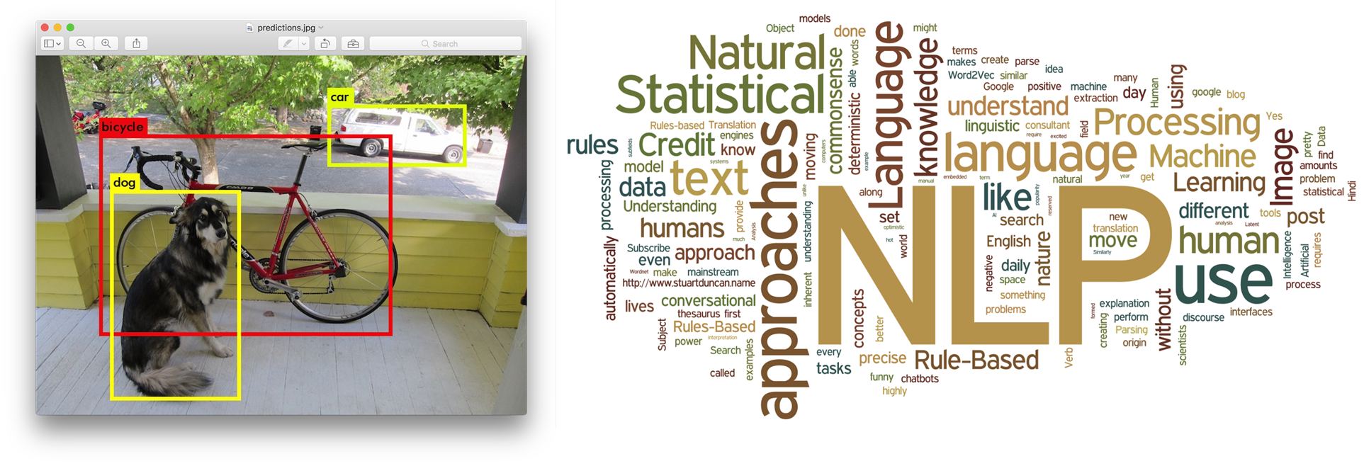
Machine Learning vs Deep Learning
Deep Learning really shines when it comes to complex problems such as image classification, natural language processing, and speech recognition.

Slide 30
Machine Learning vs Deep Learning
Machine Learning | Deep Learning
Machine Learning Algorithms perform well when data size is not too large. | Deep learning algorithms need a large amount of data.
Machine learning can work on low-end machines. | Deep learning algorithms heavily depend on high-end machines.
Machine learning model comparatively takes much less time to train. | Deep learning algorithm takes a long time to train.

Slide 31

機器學習 YouTube 頻道
Pokémon Master
Search “Machine Learning” or “機器學習” on YouTube

Slide 32
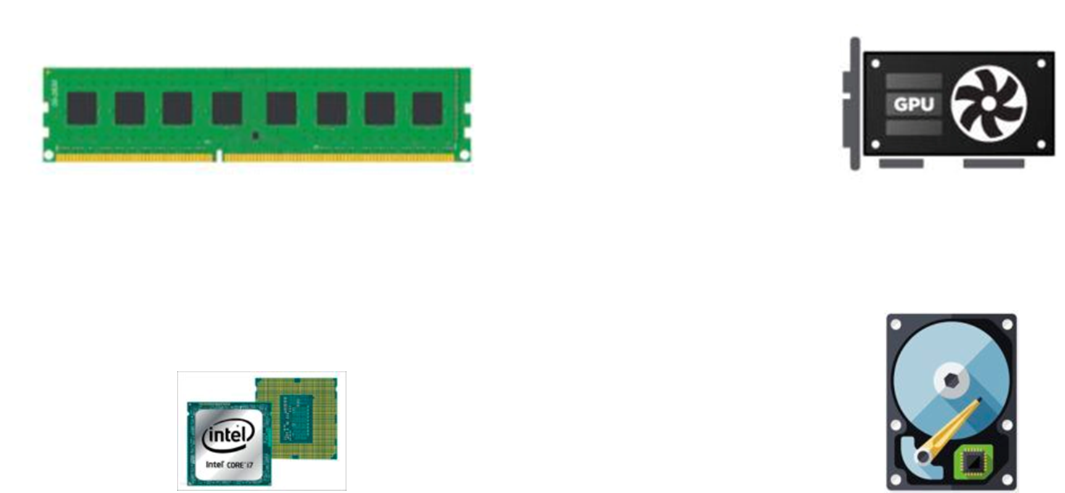
Hardware Requirement
RAM: 16 GB
GPU: NVIDIA GeForce 10 series
CPU: Intel Corei7 7th Generation
Storage: 1TB HDD, 256 GB SSD, or Cloud Storage Options

Slide 33

Operating System
Linux
Apple
Windows

Slide 34

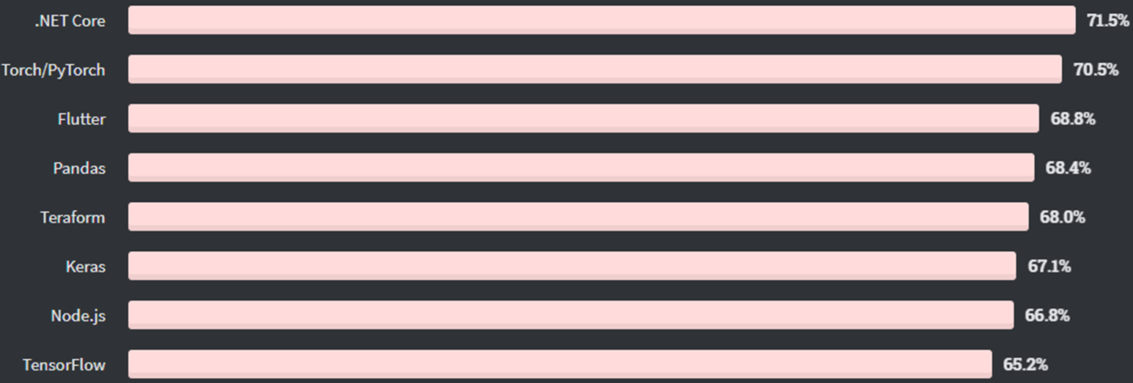
Most Loved Other Frameworks, Libraries, and Tools
Stack Overflow’s 2020 Developer Survey

Slide 35
Keras vs Tensorflow vs Python
Google Trends Popularity
Keras
Popularity
Tensorflow
Pytorch

Slide 36
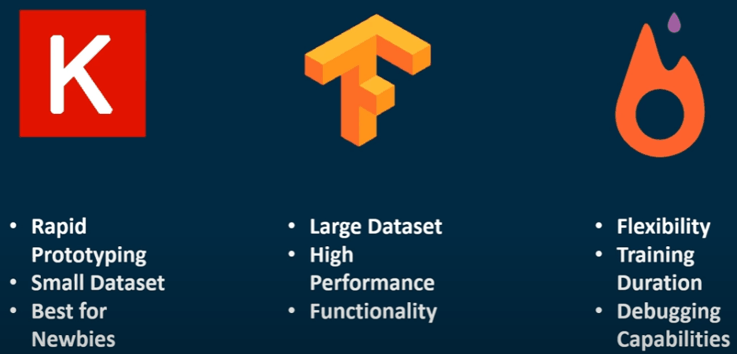
Keras vs Tensorflow vs PyTorch

Slide 37

Python
Numpy
Pandas
SciPy
Matplotlib
SciKit-Learn

Slide 38

Introducing Keras
Compatible with: Python 3
Capable of running on top of TensorFlow
Allows for easy and fast prototyping (through user friendliness, modularity, and extensibility).
Supports both convolutional networks and recurrent networks, as well as combinations of the two.
Runs seamlessly on CPU and GPU.

Slide 39
Three API Styles
The Sequential Model
The functional API
Model subclassing (sometimes needed to debug)

Slide 40
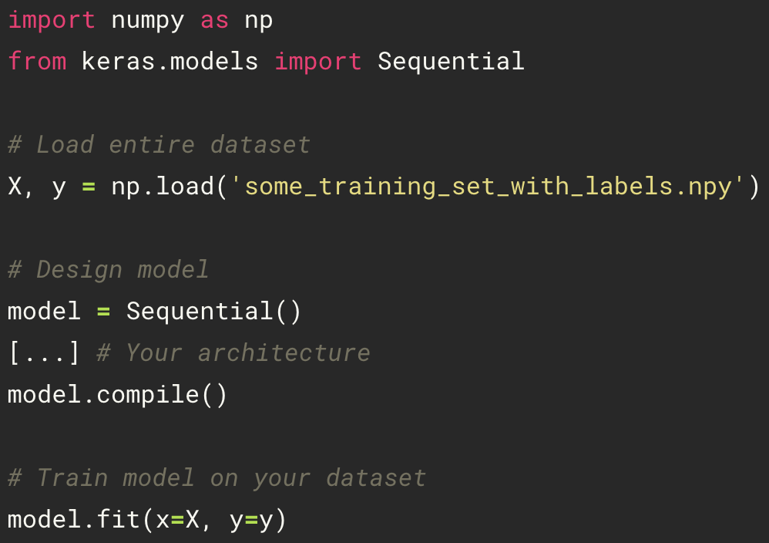


Keras data generator
Link

